Slide 1

Precision-Nutrition Startups and Biotech Workforce Creation
Exploring North America's precision-nutrition startups driving biotech workforce growth and deep-tech innovation for strategic investment.
AI-Generated Presentation • Confidential

Slide 2
Executive Summary
1
2
3
4
5
Market size
Growth rate
Investment
Innovation
Segmentation
North America accounts for 50% of global precision nutrition revenue
Canada's precision nutrition market projected to grow at 18.2% CAGR from 2025 to 2032
U.S. leads the global market with 39% of global revenue in 2024
Key innovation hubs include Boston/Cambridge and San Francisco Bay Area
Market expanding through AI-driven platforms, biomarker-based services, and functional supplements
2

Slide 3

Definition
1
Precision nutrition involves personalized dietary recommendations based on genetic profiles and health data
Introduction to Precision Nutrition and Biotech Ecosystem
Applications
2
Precision nutrition has applications in chronic disease management and prevention
Ecosystem
3
Biotech workforce creation is crucial for the growth of the precision nutrition industry
Innovation hubs
4
Boston/Cambridge and San Francisco Bay Area are key hubs for precision nutrition innovation
Investment
5
Strong investment ecosystem supports the growth of precision nutrition startups
3

Slide 4
Precision Nutrition Market Analysis: North America Focus
MARKET SHARE
GROWTH RATE
REVENUE
U.S. accounts for 39% of global precision nutrition revenue in 2024
Canada's precision nutrition market projected to grow at 18.2% CAGR from 2025 to 2032
North America accounts for up to 50% of global precision nutrition revenue
4

Slide 5
North America Precision Nutrition Market Projections
REGION
2024 MARKET SHARE (%)
PROJECTED CAGR (2025–2032)
PROJECTED MARKET VALUE BY 2032 (USD MILLION)
United States
81.0
15.3 %
5 469
Canada
10.3
18.2 %
N/A
Mexico
N/A
17.3 %
N/A
3 records · 4 metrics · Source: Document Analysis
5

Slide 6
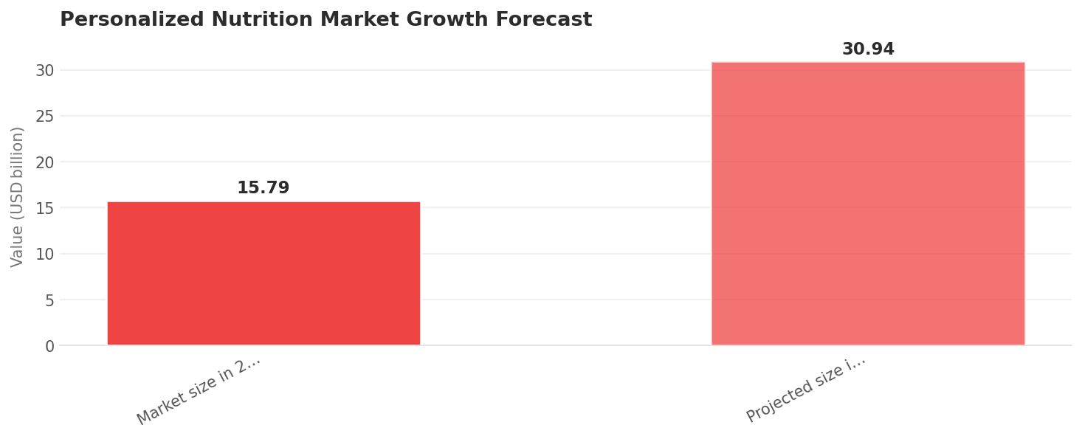
Personalized Nutrition Market Growth Forecast
Data visualization from document analysis
📊
6

Slide 7
Investment Landscape and Capital Formation
OPPORTUNITIES
CHALLENGES
U.S. investment: Strong investment ecosystem supports precision nutrition startups
Opportunities: Growing demand for personalized nutrition drives investment opportunities
Canadian investment: Canada's precision nutrition market attracts significant investment
Partnerships: Collaborations between startups and established companies drive innovation
Challenges: High costs and regulatory hurdles hinder investment in precision nutrition
Funding: Government funding and grants support precision nutrition research and development
7

Slide 8
Technological Drivers and Innovation Trends
01
02
03
04
05
Artificial intelligence
Genomics
Digital health
Biomarkers
Functional supplements
AI drives personalized nutrition recommendations
Genetic profiles inform personalized nutrition plans
Digital health platforms support precision nutrition services
Biomarker-based services enable targeted nutrition interventions
Functional supplements support personalized nutrition plans
8

Slide 9
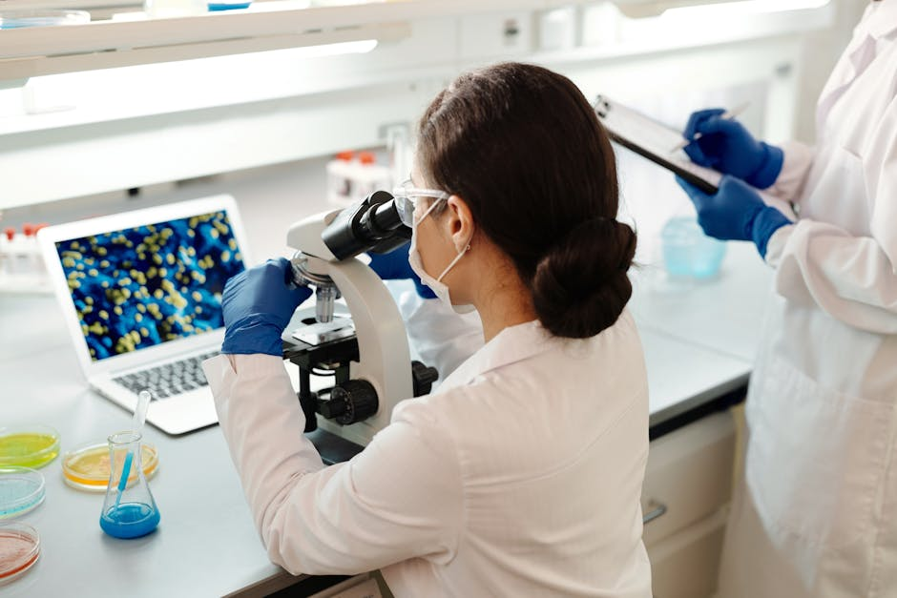
Workforce demands
1
Growing demand for skilled biotech professionals
Biotech Workforce Demands and Talent Ecosystem
Talent ecosystem
2
Strong academic and research institutions support biotech workforce development
Skills gap
3
Skills gap in data analysis and interpretation hinders biotech workforce growth
Training programs
4
Training programs and workshops support biotech workforce development
Partnerships
5
Collaborations between industry and academia drive biotech workforce growth
9

Slide 10
Precision Nutrition Market to Reach $150 Million by 2025
Market growth: Precision nutrition market projected to reach $150 million by 2025
Investment: $8.5 million invested in precision nutrition startups in 2022
Growth rate: Precision nutrition market growing at 18.2% CAGR
10

Slide 11

Conclusion
→
Precision nutrition market growth: North America accounts for up to 50% of global precision nutrition revenue
→
Investment opportunities: Growing demand for personalized nutrition drives investment opportunities
→
Biotech workforce growth: Strong academic and research institutions support biotech workforce development
→
Innovation trends: AI, genomics, and digital health drive precision nutrition innovation
→
Future outlook: Precision nutrition market projected to reach $150 million by 2025
11

